Slide 1
Digital Portfolio
STUDENT NAME: JANANI K
REGISTER NO AND NMID: 212401005/
11E9795E0AA5890999246106698B8149
DEPARTMENT: COMPUTER APPLICATION
COLLEGE:COLLEGE/ UNIVERSITY PRINCE SHRI VENKATESWARA ARTS AND SCIENCE COLLEGE
MADRAS UNIVERSITY

Slide 2
PROJECT TITLE
DIGITAL
PORTFOLIO

Slide 3


AGENDA
Problem Statement
Project Overview
End Users
Tools and Technologies
Portfolio design and Layout
Features and Functionality
Results and Screenshots
Conclusion
Github Link
3/21/2024 Annual Review

Slide 4

PROBLEM STATEMENT Many students and aspiring developers struggle to present their skills and projects in a professional, visually appealing, and interactive way. Traditional resumes are limited and cannot showcase design skill

Slide 5
Live projects, or creativity effectively. A digital portfolio solves this by providing an interactive and engaging platform to display technical abilities and personal branding.

Slide 6

PROJECT OVERVIEW This project is a personal digital portfolio for Janani K. a Il BCA student, designed to: Present skills in HTML,CSS and JavaScript. Showcase projects with a modern animated interface

Slide 7
Highlight interest in UI/UX design and modern web frameworks. Provide easy navigation for potential employers. Clients, or peers to explore work and contact information.

Slide 8

WHO ARE THE END USERS? Recruiters & Employers to evaluate skills and creativity for internships or jobs. Peers & Collaborators projects. Clients to explore design and development capabilities for freelance work. Academicians for academic evaluations and project submissions.

Slide 9

TOOLS AND TECHNIQUES HTML For creating structured web content. CSS For styling, animations, and responsive layout. JavaScript For interactivity and dynamic content

Slide 10
POTFOLIO DESIGN AND LAYOUT
Hero Section: Clean background with a greeting and title “Hi. I’m Janani K”. About Me Section: A short description of skills, passion, and current academic status. Projects Section: Highlights of work like interactive portfolio and responsive landing page.
10

Slide 11
Contact Section: Email, GitHub, and Linkedin links for professional reach. Footer: Copyright statement. Theme: Modern, minimalistic, with a soft color palette and elegant typography.

Slide 12
FEATURES AND FUNCTIONALITY Responsive Design Works on all screen sizes. Smooth Scrolling & Animations Enhances user experience. Clickable Links Easy navigation to GitHub and LinkedIn.

Slide 13
Organized Sections About Me. Projects, and Contact for better user flow. Modern Ul Elements Clean cards, icons, and alignment for professional look.

Slide 14
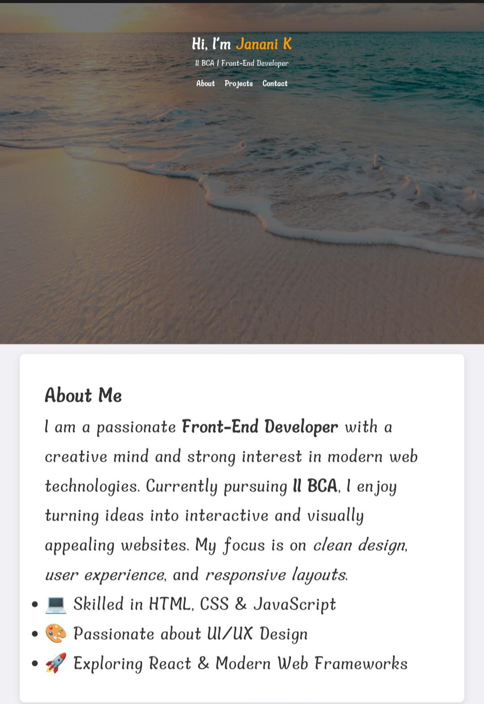

RESULTS AND SCREENSHOTS
3/21/2024 Annual Review
14

Slide 15
CONCLUSION This digital portfolio effectively showcases Janani K’s technical expertise and creative design skills. It is a strong tool for career building, academic evaluation, and professional networking, proving capability in HTML, CSS, JavaScript, and UI/UX design principles.
15

Slide 16
GITHUB LINK
https://github.com/JananiKarnamaharajan-max/TNSDC-FWD-DP.git

